Slide 1

January 2020
Customizing online real estate search engine results according to a personal profile

Slide 2
Introduction
Looking for a home in a new city can be a challenging task.
Most of us don't know the ins and outs of a city before we decide to move there, so choosing the right home will usually require an extensive research.
Not everyone has the time or knowledge to perform such a comprehensible research.

Slide 3
Business Problem
An online real estate search engines that recommends neighborhoods according to an online profile.
The online profile will have information such as age, marital status, education, hobbies etc.
Useful for people who don’t have the time or ability to research this themselves, and to developers of online real estate search engines that can use this approach to add an extra feature that will set them apart from the competition.

Slide 4
Data
This report focuses on the city of Los Angeles, however, the methods shown here can be used for potentially any major city.
Los Angeles, or L.A., is the most populous city in California.
Home to more than 10 million people, Los Angeles County is comprised of nearly 300 communities that vary greatly from one another.
For someone who is not familiar with the area choosing the right neighborhood can be a very daunting task.

Slide 5
Data Sources
The Neighborhood Data for Social Change (NDSC) –
This platform is a project of the USC Price
Center for Social Innovation, a free publicly
available online resource for civic actors to
learn about their neighborhood.
Foursquare API

Slide 6
Data Preparation
Demographic data about L.A. neighborhoods was obtained from the NDSC portal (neighborhoods and their coordinates, age distribution, marital status, education, average household size, unemployment rate, crime rate and total number of population).
100 of the most popular venues within a 500 m radius of the center of each neighborhood were gathered using the foursquare API.

Slide 7
Methodology
Stage I – cluster neighborhoods according to the demographic data.
Find the cluster that fits the personal data of the user.
Stage II – Cluster neighborhoods according to the types of venues they have.
Find the cluster that fits the user’s hobbies.

Slide 8
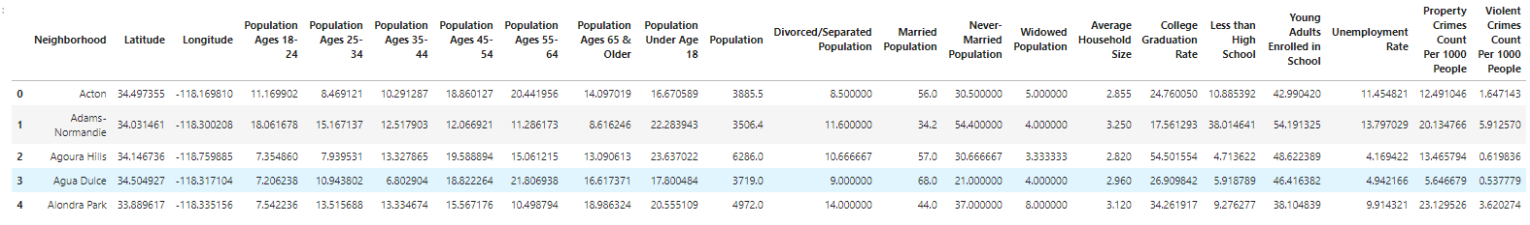
Methodology
A data frame representing each neighborhood and its features.
This data will be used to cluster the neighborhoods.

Slide 9
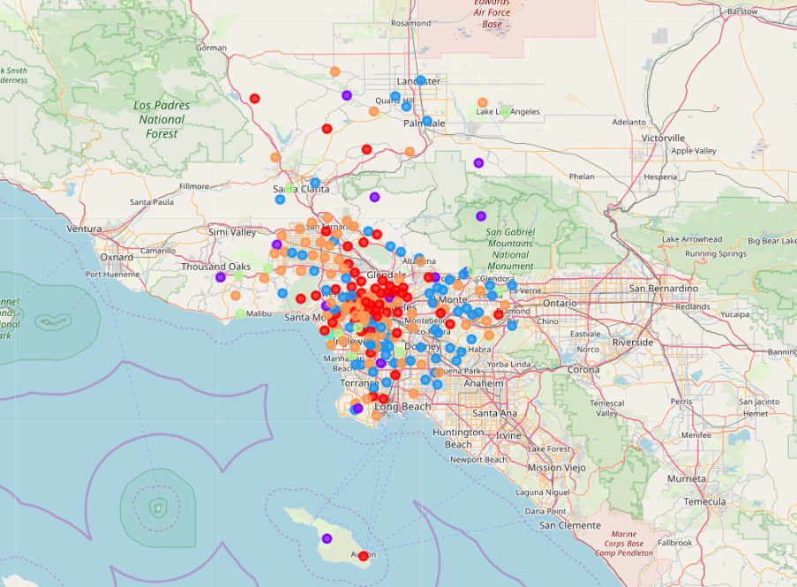
Methodology
L.A neighborhoods clustered according to demographics

Slide 10
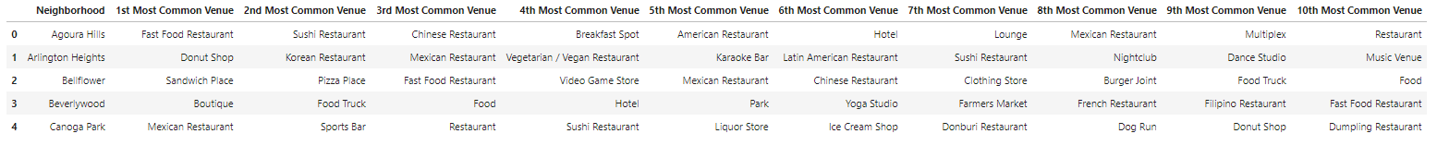
Methodology
100 of the most popular venues within a 500 m radius of the center of each neighborhood were gathered using the foursquare API. The 10 most common venues in each neighborhood were collected in a data frame.

Slide 11
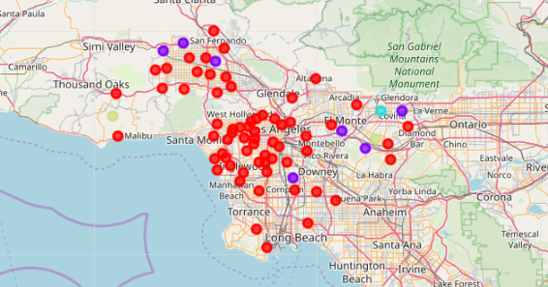
Methodology
L.A Neighborhoods clustered by Venues

Slide 12
Results
Neighborhoods were divided into clusters. In the first stage the clusters were formed using demographic data of each neighborhood. Mean values of each cluster were calculated.
This data will allow us to match a user to the cluster that best fits his personal status.
For instance, if the user is a 23 years old single man, with a collage degree, we can look for a cluster where a large percent of the population is single and has a collage degree.

Slide 13
Results
The second part will be to cluster the neighborhoods according to the venues.
Looking at the top number of venues in each cluster we can recommend a cluster according to the users' hobbies.
For instance, if a user enjoys spending time outdoors, we can look for a cluster where the top venues are parks.

Slide 14
Conclusion
Using simple methods it is possible to save the effort that goes into researching a new city.
Online real estate search engines can use this method to customize the properties list they show each user.

